Slide 1

Project Flags
CAPTURE THE FLAG CHALLENGES
Hacking for good

Slide 2
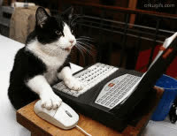
Definition: Capture the flag challenges are ways that we can compete and prove our skills in a ethical environment
Objective: We are going to go over how to compete in a competition and go over studying for one.
And... Win some competitions.
THE OBJECTIVES

Slide 3

WHY TRY CAPTURE THE FLAGS?
Demonstrate practical security skill to employers
Network with Cybersecurity Professionals
An amazing resume builder.
Where do you land in cybersecurity?

Slide 4
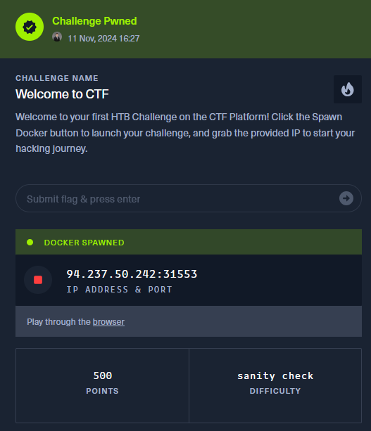
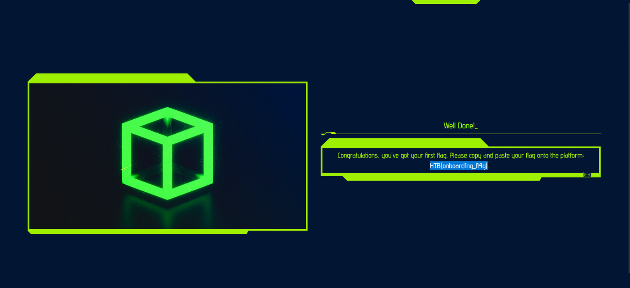
UNDERSTANDING A CTF
A CTF: An exercise which participants attempt to find text strings (Flags) which are hidden in systems
HTB{onboard1ng_fl4g}

Slide 5

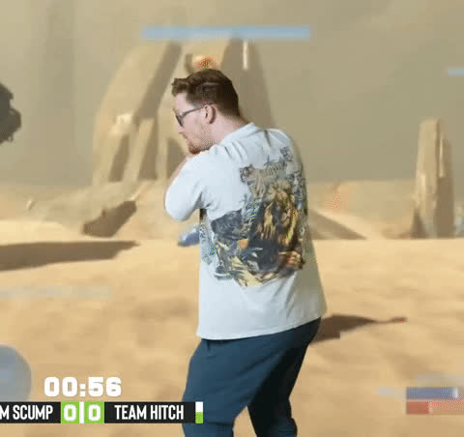
TYPES OF CTFS
Jeopardy-Style
Attack - Defense
Multiple challenge categories
Collegiate Cyber Defence Competition
The classic “Text challenges”
Defending servers against attack / Attacking others
Decode: ZmxhZ3tmbGFnfQ==
flag{flag}
Not currently in scope for our CTF team

Slide 6
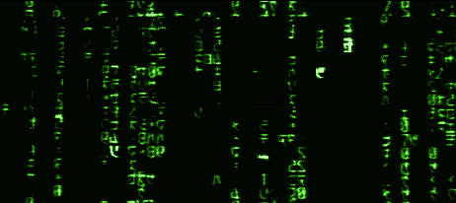
WHAT KINDS OF CHALLENGES WILL WE SEE?
“Active”
PWN aka compromise a machine
WEB Web vulnerabilities (sql injection, fuzzing, etc)
ICS - Industrial Control Systems (Rare)
“Passive (No Server interaction)
Warm ups
Cryptography
Reversing
Foresnsics
Misc

Slide 7
WHEN YOU ARE STUCK:
TIPS AND TRICKS
MOVE ON - If you can’t figure it out right now sometimes it is best to move on
Find a new approach – Look for write ups in the area you are working on. SEe if there is a new approach
TEAM HELP - Gather ideas from friends and see if they can assist, working together on a challenge can help bring new perspectives

Slide 8
A NOTE ABOUT THE CHALENGING NATURE
"The expert in anything was once a beginner who refused to give up."
- Helen Hayes

Slide 9
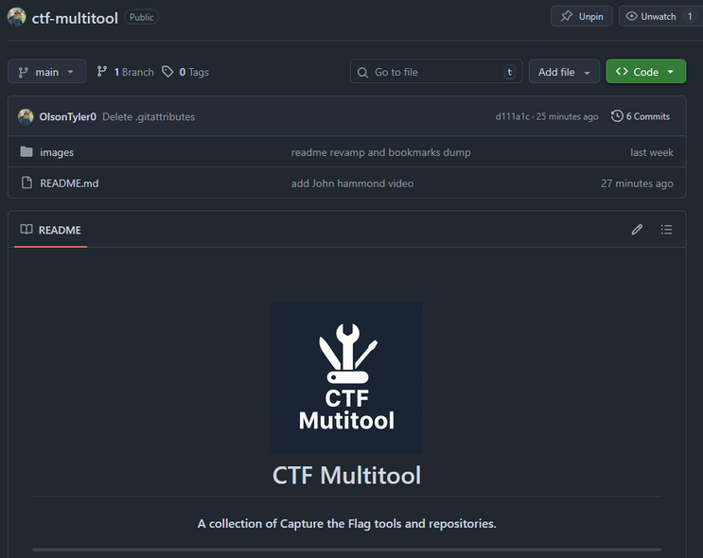
THE TOOLING
As we continue with training I’ll share more of the tooling we use.
Githubs with massive amounts of tools collected over time “CTF tool list site:Github.com”
Custom github repo at:
https://github.com/OlsonTyler0/ctf-multitool

Slide 10

LETS LOOK AT TODAY’S CTF!

Slide 11

THANK YOU
https://github.com/msu-abits/2025-cybersecurity

